Slide 1
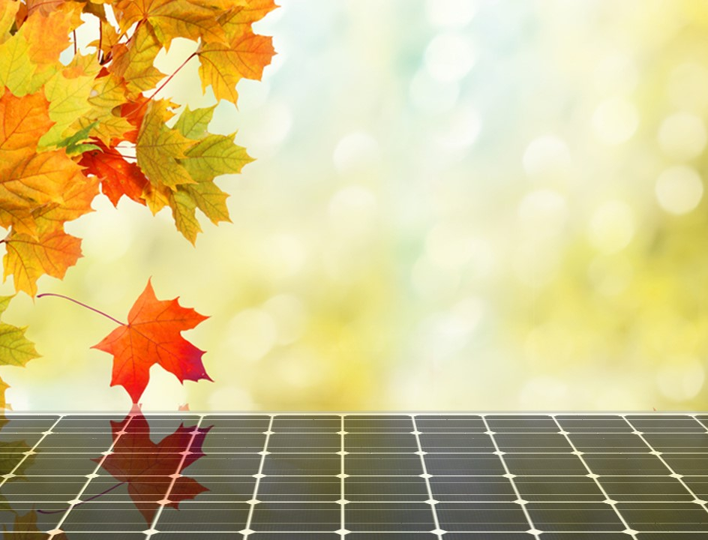
WELCOME
Holy Trinity Green Team!
HOME SOLAR OVERVIEW
Presented by Laureen Peck, Chief Marketing Officer

Slide 2
About Us

Slide 3
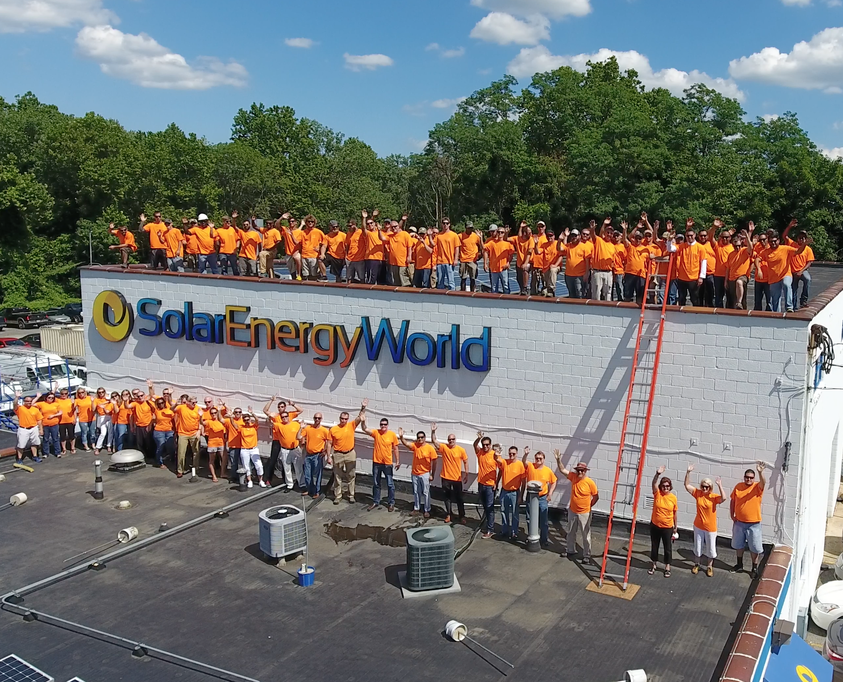
Solar Energy World Supports the Local Economy
One of Region’s Fastest Growing, Green Jobs Creator
Thousands of solar systems in the Maryland/DC metro area since our founding in 2009.
Expanded into PA in 2017
Expanded into NJ in 2018
Expanded to VA and Florida in 2019
Projected to increase 2019’s installations by 30% in 2020, now averaging 130-140 new installations a month.
All of our installers are full-time employees. (We do not send subcontractors to your home.

Slide 4
WHY GO
SOLAR?
- Environmental Benefits - Stats & Facts about the
Solar Industry

Slide 5
SPILLS AND ACCIDENTS FROM DIRTY ENERGY
ARE NOW COMMON
PLACE
WEST VIRGINIA
Coal Chemical Leak
FLORIDA
Oil Spill
PENNSYLVANIA
Gas Fracking

Slide 6
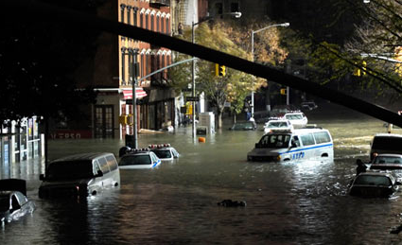
97% of Accredited Climate Scientists worldwide agree, "Observations throughout the world make it clear that climate change is occurring, and rigorous scientific research demonstrates that the greenhouse gases emitted by human activities are the primary driver.”
OREGON
NEW YORK
MARYLAND
CALIFORNIA
Source: NASA https://climate.nasa.gov/scientific-consensus/

Slide 7
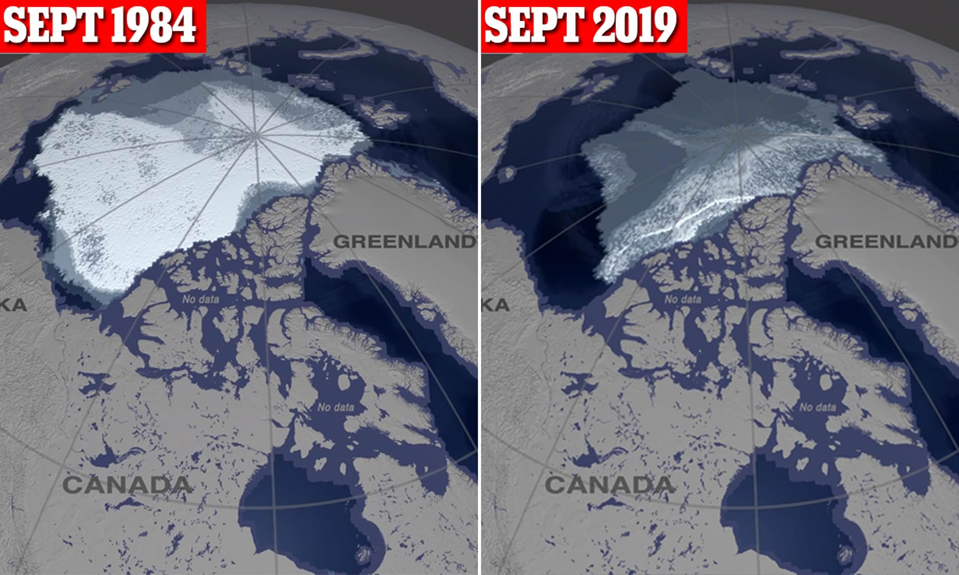
Human Activities’ GHG Effect on Climate Change*:
*Source: NASA, 2019

Slide 8
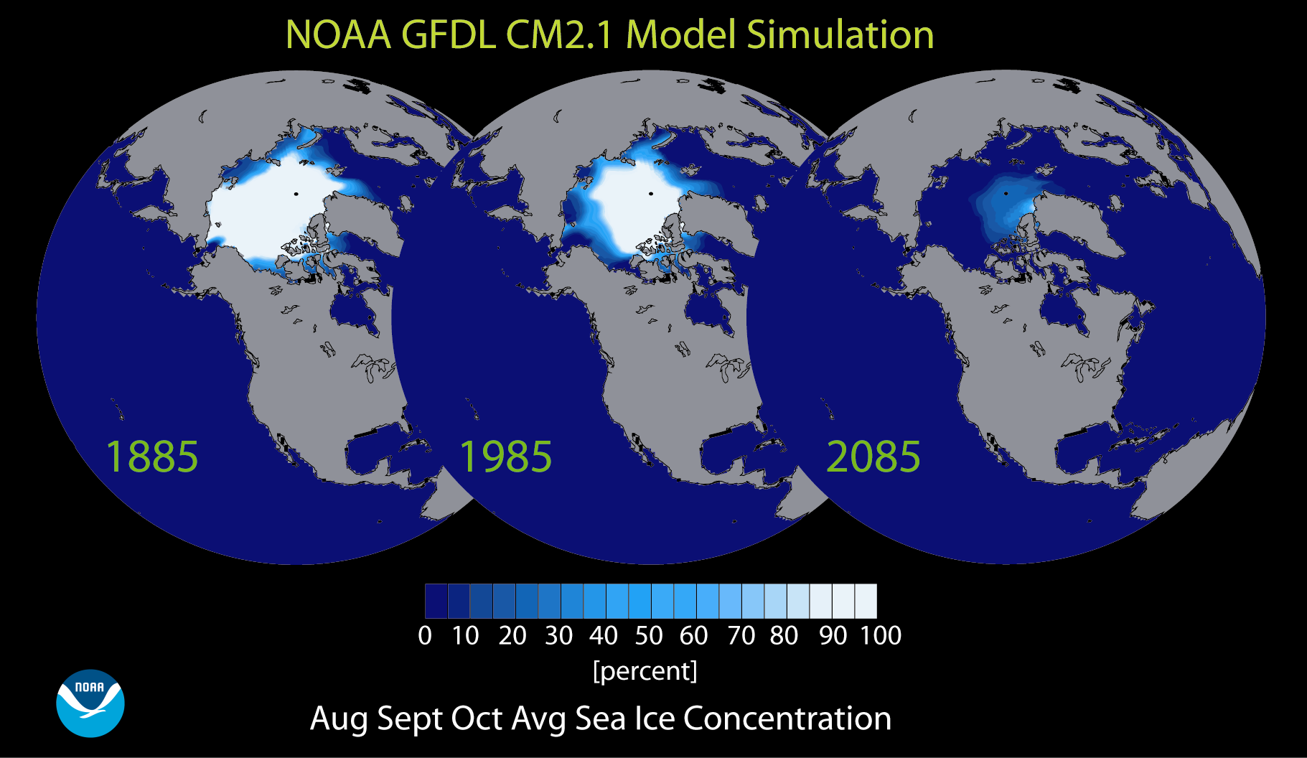
Arctic Ice Melt is Accelerating*
*Source: NOAA, 2019

Slide 9
BAD NEWS
In October 2018, The Intergovernmental Panel on Climate Change*, the UN’s climate-change body stated:
“We only have 12 years to save ourselves from utter devastation from climate change. … if we do nothing about it now the earth’s resources will be ravaged and humankind and the rest of the living things on this planet will be fighting for survival.”
*The report was built from more than 6,000 scientific references from 91 authors across 40 countries and outlines the impact of global warming exacerbated by human activity. The report calls for “rapid, far-reaching and unprecedented changes in all aspects of society.”, Oct. 2018

Slide 10
Why the US Solar Industry Remains Unstoppable

Slide 11
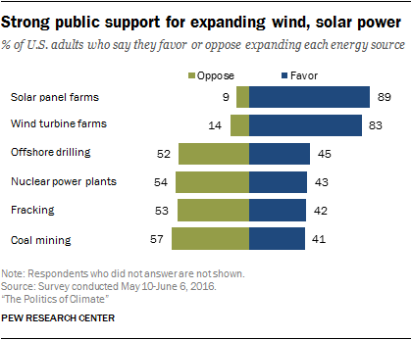
Both self-identified Democrats and Republicans support the idea of the nation transitioning towards renewable sources of energy*
Solar and wind power are the top two preferred alternative energy sources among both groups while coal ranks dead last.
The use of renewable energy sources like wind and solar power has doubled in the last decade
*Sources: Business Insider, Gallup Poll, US Energy Information Administration, Pew Research

Slide 12
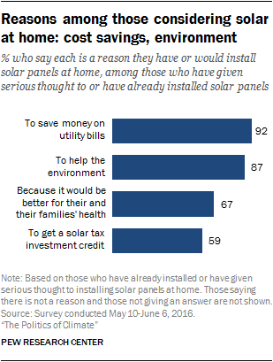
What is the Main Reason Why Support for Solar Crosses Party Lines?
Whether or not you believe fossil fuels have a negative environmental impact, everyone likes saving money!

Slide 13
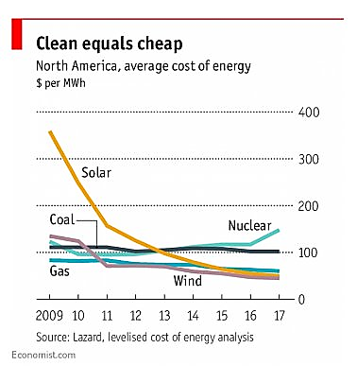
The cost of solar power is decreasing so rapidly, it's now cheaper than coal!

Slide 14
Source: SEIA 2019

Slide 15
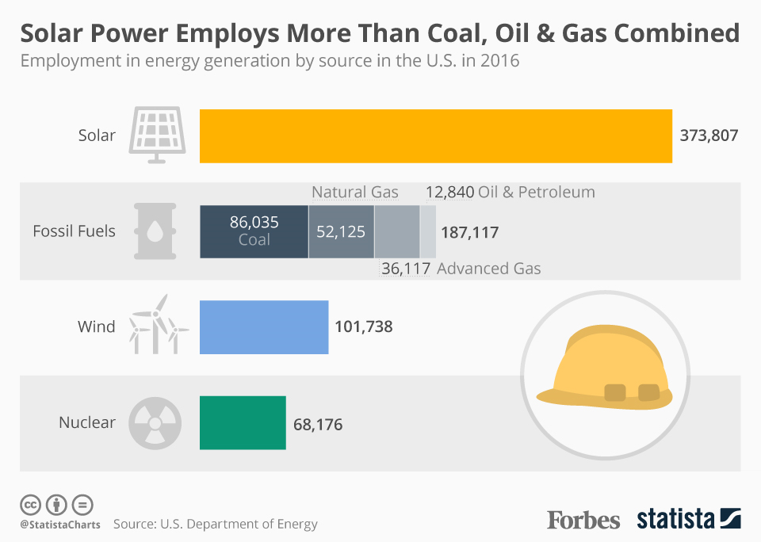
Source: U.S. Department of Energy

Slide 16
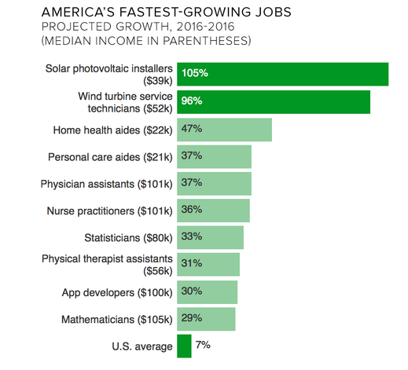
EVEN MORE EXCITING…
Solar job growth now outpaces growth from all other jobs!
Solar jobs are growing 20 times faster than the national average.
Source: Bureau of Labor Statistics

Slide 17
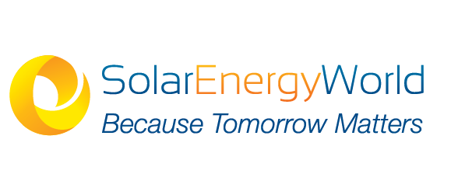
How Do Solar Electricity systems Work?

Slide 18
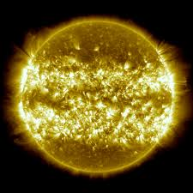
Solar Power is Reliable
Solar electricity has been used for decades
Millions of people rely on this technology every day
Solar power is easily
adaptable for your home:
(No Moving Parts & Virtually ZERO maintenance)
Notes:
So, Why Solar?
The #1 reason solar has emerged as a viable renewable energy technology today is reliability! The technology that we use today was invented almost 60 years ago and the first solar array was installed in the United States in the 1960’s, it still functions today! Solar Arrays are extremely reliable, and almost all of the panels sold today carry a warranty of 25 years! Imagine a car with a 25 year warranty, or a washing machine!
A typical solar array has no moving parts, so over time there is a very high uptime of these systems. Solar arrays are designed to have a minimum useful lifespan of 25 years, systems routinely last longer than that.
With no moving parts there is also virtually no maintenance. In more arid climates you do need to wash panels routinely to prevent soiling, however we get enough rainfall in our area that this is rarely necessary.
18

Slide 19
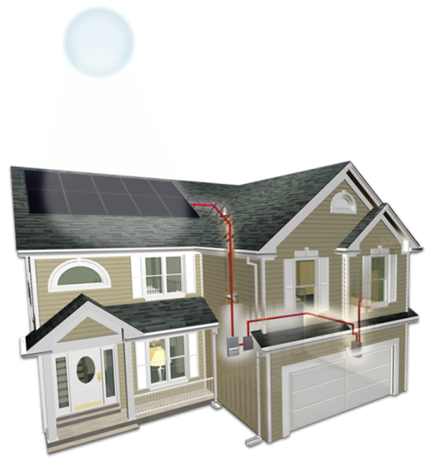
Solar Electricity Overview
Solar Panels
Monitoring
Converts sunlight into electricity.
Some systems offer monitoring services which report system performance data.
Electric Meter
Connects the system to the grid. Spins backwards when production exceeds usage.
Inverter
Converts solar electricity for household use.

Slide 20
What Makes the Best Solar Panels?
High efficiency panels
10-year defect warranties, 25 or 30-year performance warranties
No one size fits all – Solar PV products from all over the world US, Canada, Germany, China, Korea, Japan - largest suppliers with US Manufacturing facilities

Slide 21
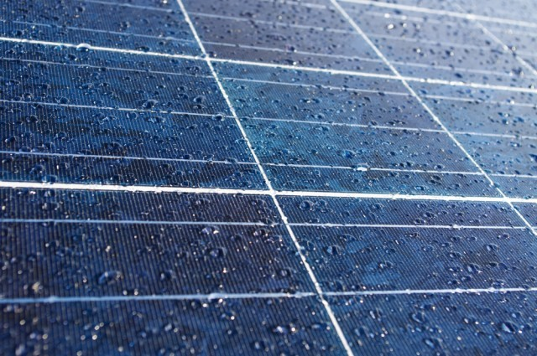
Do solar panels still generate electricity when it is raining or cloudy?
Panels operate most efficiently in full sun, but they don’t stop producing electricity when it is raining or cloudy.
Visible light (UV) gets through rain and clouds
“Rain coming and very overcast. Solar system still generating almost 2kw! We generated 86% of our needed electricity yesterday. Thanks Solar Energy World!” – Mark L. via Facebook

Slide 22
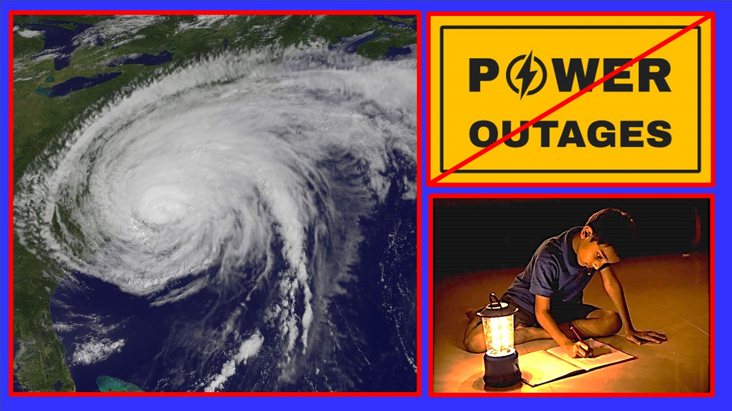
Will you still have electricity during a power outage if you have solar panels?
If you also have our back-up solar battery installed, it can power your refrigerator and other essentials.

Slide 23
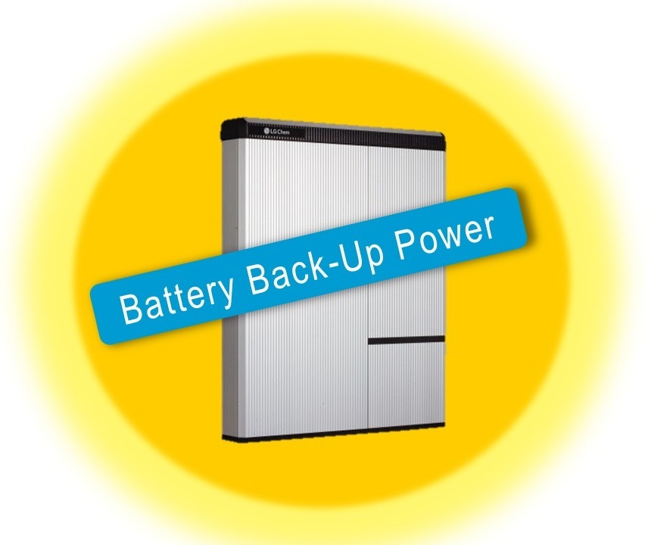
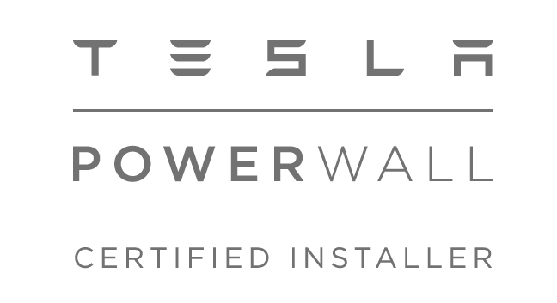
Is having a solar battery back-up system worth the cost?
THE BOTTOM LINE:
All Solar Energy World’s systems
are battery-ready. Our company now offers Tesla Powerwall, Enphase and SolarEdge storage systems.
Most of our thousands of customers do not have solar battery back-up and they still save 20-100% on their electricity and generate extra income from the excess energy their system produces RIGHT NOW.

Slide 24
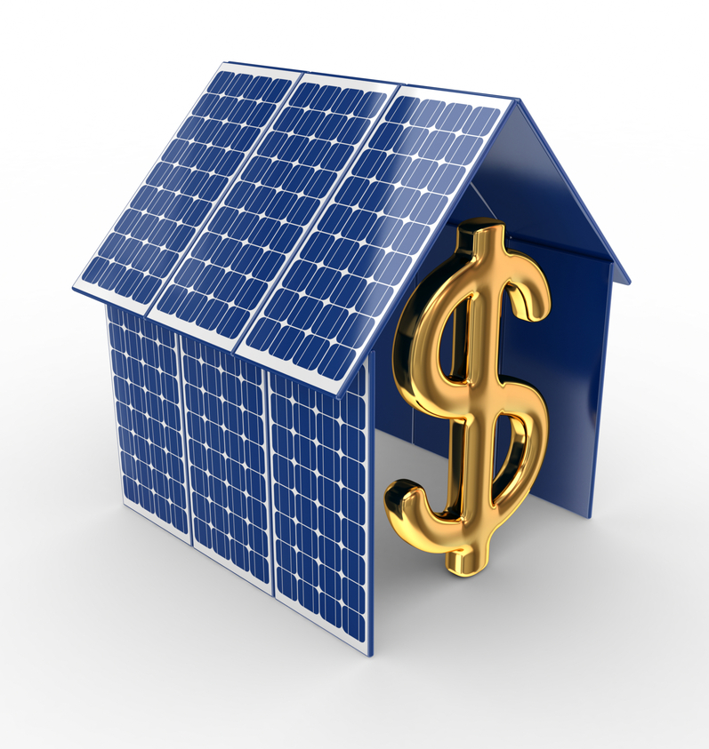
Economic Benefits of Solar

Slide 25
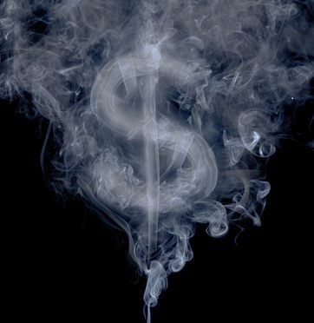
FOSSIL FUEL ENERGY ISN’T JUST BAD FOR THE ENVIRONMENT…
IT’S ALSO EXPENSIVE.
In the USA, household energy use is responsible for 50% of a home’s total operating expenses
and most of it still comes from coal-fired power plants

Slide 26
SOLAR SAVES 20-100% ON UTILITY COSTS

Slide 27
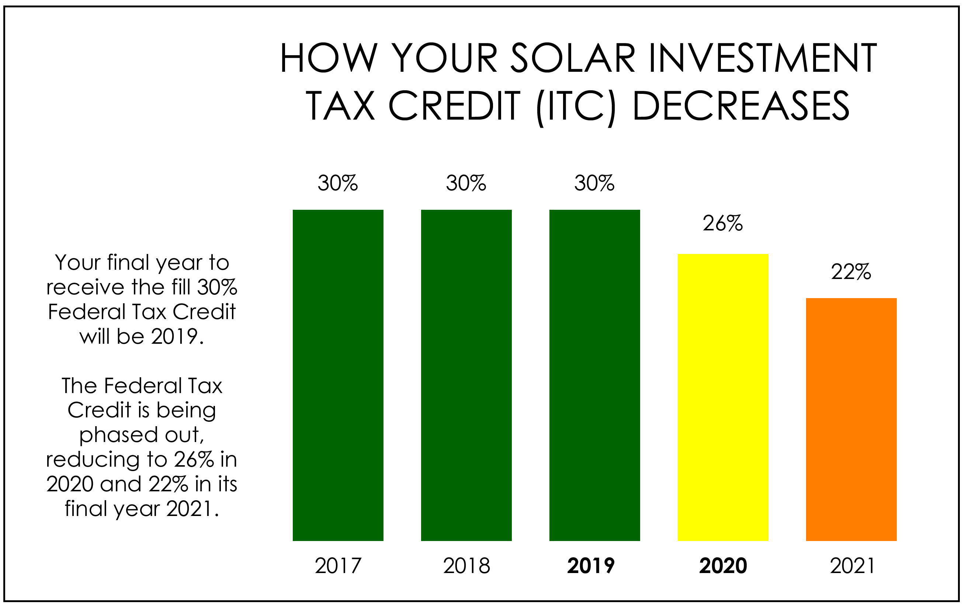
Federal Solar Incentives for Homeowners
The Federal Residential Renewable Energy Tax Credit is 26% of qualified expenses for a solar panel or solar energy system installed at your home.
This is ensured through the end of 2020, after which it will begin to decrease incrementally. In 2021, the rebate will be locked at 22%.

Slide 28
In the USA, solar power is now cheaper than fossil fuels, even without subsidies in many states.
More than 35 million Americans have made the switch to solar power at a rate cheaper than the grid.
The International Energy Agency recently announced that the world’s capacity to generate electricity from renewable sources has now overtaken coal!

Slide 29
SAVINGS
&
EARNINGS:
- Net Metering
- Grants

Slide 30
What exactly is net metering? YOU GET MONEY BACK FROM YOUR UTILITY COMPANY!
Net metering reflects the difference between electricity used from the grid less the electricity produced by your Solar PV System.
“I really enjoy watching the meter spin backwards!” – Rich Lechner, SEW customer
“I haven’t paid anything for electricity since mid-March through October!” - Jim Mattingly, SEW Customer
“My hubby saw the meter go backwards for the first time and got all excited. We love our solar system!” - Candice Stankus, SEW Customer

Slide 31
Solar is a Smart Investment
Solar Better Investment than Stocks, Study Finds

Slide 32
Think Solar is Too Expensive?
IT’S A LOT MORE EXPENSIVE TO DO NOTHING!
EXAMPLE: If you spend $200 a month on your electricity with a yearly increase of 4.5%*:
In 10 years you will have sent $35,667 to your utility company with no return on your dollars. A solar system would have paid for itself in less than 10 years.
By going solar, you’re taking this same money and investing in your home instead of in the utility company!
* National Avg. PUC data

Slide 33
How do Solar PPAs Work?

Slide 34
Is a PPA the best solution for you?
WHAT IS A SOLAR PPA?
(Power Purchase Agreement)
What are your short-term and long-term investment goals?
Do you have access to cheap capital?

Slide 35
$0 Down PPA
No Upfront Costs
Can choose fixed monthly electricity payments for a lower cost of electricity
Includes design, installation, monitoring, insurance, customer service, maintenance
Solar made easy and efficient
Term is 25 years – includes maintenance and service
Customer has option to purchase system – lease to own
Homeowner gets benefit of low utility costs

Slide 36
Recap: PPA vs Purchase
 | PURCHASE | PPA
INITIAL INVESTMENT? | $0 - Full Purchase Price | $0
MONTHLY BILL SAVINGS? | 50-100% | 20-30%
DOES SYSTEM GENERATE INCOME? | YES | NO
TAX INCENTIVES? | YES | INCLUDED
DO YOU OWN THE SYSTEM? | YES | POSSIBLE
SYSTEM WARRANTY? | YES | YES
ENERGY MONITORING? | YES | YES
EARN REFERRAL REWARDS? | YES | YES

Slide 37
6 STEPS
for an easy
Solar Installation
Process

Slide 38
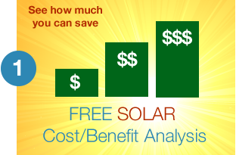
Initial Consultation
Through the use of Computer Aided Drafting, your consultant will show you what your system will look like based on engineering specific engineering requirements
Your consultant will review all applicable incentives, rebates & your Return on Investment

Slide 39
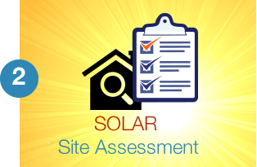
Pre-Installation
Perform physical site assessment including shade analysis
Plans are reviewed, certified and stamped by our in-house State
Licensed Professional Engineer
Submit Building Permits for County/City Electrical
Submit Interconnection Application to EDC
Notes:
What makes a good solar array?
There are a number of ingredients that go into making a residential solar installation successful. It isn’t just putting some panels on a roof and connecting that up to the homes electrical system. The real challenge for a homeowner looking to go solar is wading through all of the different incentives and regulations to ensure that the process happens as smoothly and quickly as possible. A qualified installer/integrator can usually help, and we actually do everything for our system owners, as we believe this should be our full time job, not yours.
A typical residential installation will go through these steps
39

Slide 40
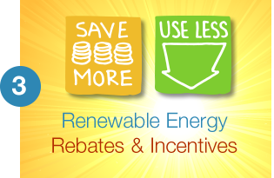
Renewable
Energy Rebates and Incentives
We complete the
solar tax credits and
rebate paperwork
to ensure that you are
getting all the financial support you are entitled to.

Slide 41
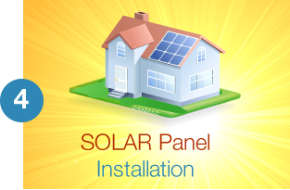
Installation
Solar Energy World does not hire sub-contractors. All installations are
performed by our
Employees who are fully accountable to us.
Install the racking and panel Systems
Complete Wiring & fully test system
Provide Homeowner System Training

Slide 42
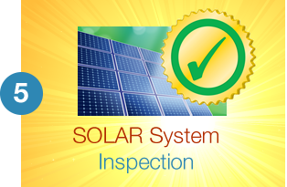
Post-Installation
Solar Energy World technician arranges & obtains final inspection approvals as required by the local jurisdiction.
Solar Energy World submits the certificate of completion to the EDC to request net-meter and approval to operate.
3-5 Weeks after Utility Notification Utility Company Installs Net-Meter and we:
Complete initial application to manage the Solar Renewable Energy Credits (SRECs) for the customer
Submit MEA Grant Forms for the customer
Notes:
What makes a good solar array?
There are a number of ingredients that go into making a residential solar installation successful. It isn’t just putting some panels on a roof and connecting that up to the homes electrical system. The real challenge for a homeowner looking to go solar is wading through all of the different incentives and regulations to ensure that the process happens as smoothly and quickly as possible. A qualified installer/integrator can usually help, and we actually do everything for our system owners, as we believe this should be our full time job, not yours.
A typical residential installation will go through these steps
42

Slide 43
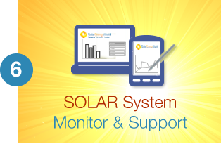
On-going Solar System Monitor and Support
We monitor your system remotely. If there is a problem, we will alert you and schedule service.
Start Saving
and
Earning!

Slide 44
QUESTIONS?

Slide 45
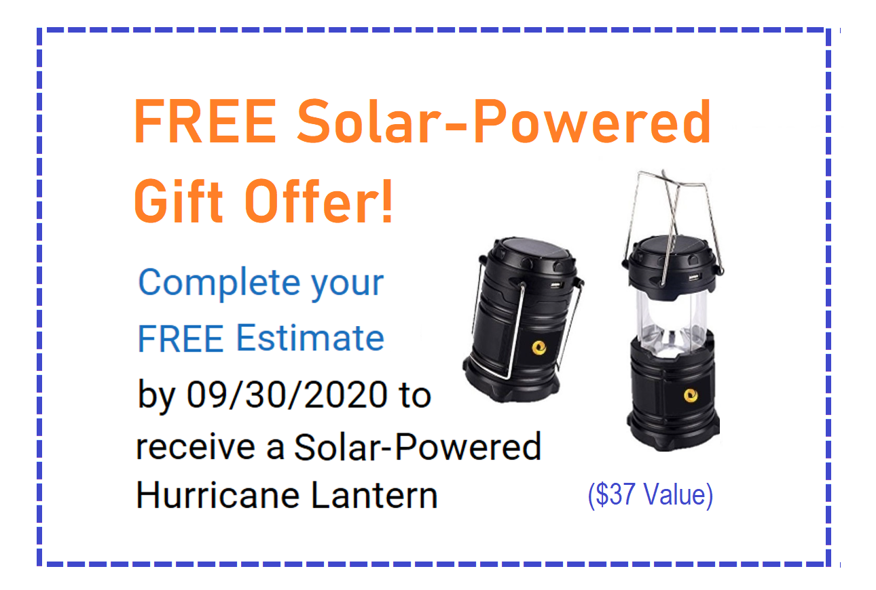
Special Offers for Holy Trinity Parishioners
Interested? Email Lpeck@solarenergyworld.com

